Slide 1
National Workshop on Integrated Water Resources Management (IWRM) European Experiences – Integrating water quality management into broader basin approach water management perspective
New Delhi, 2. – 4. February 2015
Dr. Fritz Holzwarth
Former German Water- and Marine Director

Slide 2
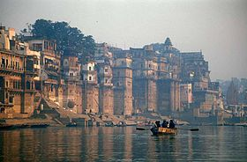
The River is a system:
quantity/quality/hydromorphology/ground-water/biodiversity/infrastructure/sediment pollution and transport ………
Point of departure/Baseline/realistic timeframe
Identify major pressures
Municipal discharges
Industrial discharges
Water balance/Abstraction
Hydromorphology
Environmental/Residual Flow
Setting priorities for measures and investments
Emission limit values/Water quality standards

Slide 3
Water Quality is determined by Water Quantity To learn from an example
Rhine Action Programme three Phases
Phase 1 Stocktaking of source, inputs, proposals for reduction, immediate actions, no regret measures
Phase 2 Reduction of inputs/monitoring impacts
Phase 3 Eventual fine tuning after intermediate stocktaking
Use Biodiversity as indicator for improved water quality and water quantity
Communication/ informing the public
Single focus on Quality no Water Balance, Quantity for granted

Slide 4
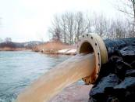
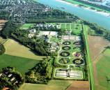
Fishes in the River Rhine 1950 - 2000
1950
without treatment
1969
treatment and monitoring
2000

Slide 5
Water Quality in the 1970s and its development at the monitoring stations Weil (yellow) Coblence (red) Bimmen/Lobith (violet)

Slide 6
Integrated Water Resources Management needs:
A common understanding about who integrates what
Institutions
Data and knowledge
Stakeholder involvement indispensable
An official jointly agreed River Basin Management Plan is needed
The governance structure needs strengthening
Responsibilities have to be clear for implementation and coordination

Slide 7
Ensure operationalization through action plan / road map
Set priorities for measures and investments following hotspots.
Develop results chains which relate measures, outputs, outcomes, final goal.
Specify detailed actions, actors, available resources, timelines.
Develop implementation monitoring based on defined indicators (potentially as part of result chain).
Envisage evaluation mechanisms at crucial timelines.

Slide 8
The Way Forward
Success factors for River Basin Management from experiences in Europe:
Follow a river basin approach
Quantity and Quality count/avoid unintended consequences
Clear decisions by Governments on all levels involving the Sector Ministries
Institutions are essential to ensure implementation and coordination
Clear and transparent communication and information strategy
Broad involvement of all stakeholders on all levels
Coherence is crucial among all levelsl
Time schedules
Priorities
Starting points

Slide 9
Integrated Riverbasin management (IRBM) can start to make a difference on the ground
Institutions existing in principle but lag of willingness to integrate vertikal/horizontal
Data and knowledge sufficient to start
Stakeholder involvement started but establish participatory processes ‘on the way’
An officially agreed River Basin Management Plan is needed
The governance structure needs strengthening
Responsibilities have to be clear for implementation and coordination

Slide 10
Thank you for your attention !
धन्यवाद !

